Slide 1
ORANGE BUSINESS
Opportunity Spaces
Innovation Radar
A regularly refreshed view of specific innovation opportunities — each scored on how attractive it is, how urgent the window is, and how strong Orange's right to win is.
MVP walkthrough · concepts · functionality · planning · architecture

Slide 2
WHY
The problem is not a shortage of information
The difference is specificity: from generic technology themes to an opportunity a salesperson can use.
REJECTED AS TOPICS
WHAT A TOPIC MUST LOOK LIKE
Generic, undated, unsourced — and disconnected from what Orange can actually sell.
Private 5G plus edge vision for safety compliance in mining
×
“AI”
TECHNOLOGY
Private 5G + edge vision
×
“Cloud”
×
“Cybersecurity”
USE CASE
Safety compliance
×
“Digital transformation in retail”
VERTICAL
Mining
Specific enough for a salesperson to use in a meeting
Orange Business · Opportunity Spaces / Innovation Radar
2
Notes:
Slide 2 — "Why": the problem isn't information, it's specificity
The gap is specificity, not volume. Everyone already has trend reports; what's missing is an opportunity concrete enough for a salesperson to raise in a customer meeting.
What gets rejected: broad themes like "AI," "Cloud," "Cybersecurity," or "Digital transformation in retail" — generic, undated, unsourced, and disconnected from what Orange can actually sell.
What qualifies: a topic built from three concrete parts — technology (private 5G + edge vision), use case (safety compliance), and vertical (mining) — combining into "private 5G plus edge vision for safety compliance in mining."
The test: could a salesperson use this in a meeting tomorrow? If not, it isn't a topic.
Bottom line: this slide sets the bar for everything the Innovation Radar tracks — only named, sellable, vertical-anchored opportunities count.

Slide 3
CONCEPT
An opportunity space is a triple
Identity is the triple. The statement is a rendering of it — both are stored.
1
STRUCTURED IDENTITY
VERTICAL
USE CASE
TECHNOLOGY
×
×
Manufacturing
OT / ICS security
SIEM and SOAR
SIEM/SOAR-based OT security analytics for legacy SCADA and ICS in brownfield manufacturing sites.
The triple gives deduplication and filtering. The statement gives the specificity a salesperson needs. A candidate that does not resolve to exactly one of each fails validation.
Orange Business · Opportunity Spaces / Innovation Radar
3
Notes:
Slide 3 — "Concept": an opportunity space is a triple
Identity = the triple. Every opportunity is defined by exactly one vertical, one use case, and one technology — e.g. manufacturing × OT/ICS security × SIEM and SOAR.
Two representations, both stored. The structured triple sits alongside a written statement such as "SIEM/SOAR-based OT security analytics for legacy SCADA and ICS in brownfield manufacturing sites."
Each does a different job. The triple enables deduplication and filtering; the statement carries the specificity a salesperson actually needs in a conversation.
It's a hard validation rule. A candidate that doesn't resolve to exactly one of each fails — no partial or multi-valued entries get in.
Bottom line: the triple is what makes the radar machine-usable and the statement is what makes it sales-usable; an opportunity only exists when both hold.

Slide 4
CONCEPT
How each opportunity is scored
The three scores stay separate.
ATTRACTIVENESS
RIGHT TO WIN
CONVICTION
Is the world moving?
Can Orange play & win?
Do our own people believe it?
30%
Signal strength
25%
Offer match
Strategy
Strategic fit
20%
Reference density
Sales
Customer demand
20%
Source diversity
15%
Partner coverage
20%
Evidence quality
Presales
Deliverability
12%
Compliance fit
15%
Novelty / momentum
12%
Capability depth
15%
Strategic relevance
8%
External validation
8%
Technology ownership
EXAMPLE SCORE
EXAMPLE SCORE
EXAMPLE SCORE
61.23 / 100
88.00 / 100
75.6 / 100
Market evidence
Orange Business Graph
Human assessment
4
Orange Business · Opportunity Spaces / Innovation Radar
Notes:
Slide 4 — "Concept": how each opportunity is scored
Three separate scores, never blended. Attractiveness ("is the world moving?"), Right to Win ("can Orange play and win?"), and Conviction ("do our own people believe it?") each stand on their own.
Attractiveness is evidence-driven — weighted across signal strength, source diversity, evidence quality, novelty/momentum, and external validation, so it reflects what the market is actually doing.
Right to Win is capability-driven — offer match, reference density, partner coverage, compliance fit, capability depth, and technology ownership.
Conviction is people-driven — an internal read split across strategy, sales, and presales, so the field's belief is captured explicitly rather than assumed.
Everything lands on a 0–100 scale, with the illustrative example showing how one opportunity can score strongly on one dimension while lagging on another.
Bottom line: keeping the three axes separate is the point — it shows why an opportunity is or isn't worth pursuing, instead of hiding the trade-off inside a single number.

Slide 5
CONCEPT
Evidence before generation
The model never invents a topic from its own knowledge. It reorganises retrieved, dated, attributable evidence.
1
2
3
4
EVIDENCE BINDING
CLOSED VOCABULARY
NO GENERATED NUMBERS
ENTAILMENT CHECK
Every claim cites signal IDs
→
Taxonomy values are validated
→
Looked up + attributed, or absent
→
Does the evidence support the claim?
The signal IDs must exist in the cluster that produced the candidate. Un-cited claims are stripped, not rewritten.
Values must match the enumerations. A recognised synonym is repaired once; anything else is dropped.
Market sizes, growth rates and percentages are looked up and attributed, or they are absent. Backstopped by a regex.
A second model pass verifies each claim against the cited span.
LIVE RUN
345 of 644 candidates rejected
with specific, written reasons
A separate critic prompt scores 1–5 as the MINIMUM across five tests, so one failure caps the whole score.
Orange Business · Opportunity Spaces / Innovation Radar
5
Notes:
Slide 5 — "Concept": evidence before generation
The model never invents topics. It reorganizes retrieved, dated, attributable evidence rather than drawing on its own knowledge.
Four guardrails, applied in sequence. Evidence binding — every claim cites signal IDs that must exist in the source cluster, and uncited claims are stripped rather than rewritten. Closed vocabulary — taxonomy values must match the enumerations; a recognized synonym is repaired once, anything else is dropped. No generated numbers— market sizes, growth rates and percentages are looked up and attributed or simply absent, backstopped by a regex. Entailment check — a second model pass verifies each claim against the cited span.
Scoring is deliberately unforgiving. A separate critic prompt scores 1–5 as the minimum across five tests, so a single failure caps the whole score.
It bites in practice: in a live run, 345 of 644 candidates were rejected, each with a specific written reason.
Bottom line: this is the trust layer — the rejection rate is the evidence that the guardrails are real, not decorative.

Slide 6
CONCEPT
Portfolio distance decides whose conversation it is
The shortest path from a topic to a configuration Orange could actually deliver.
L0
Direct
An existing offer addresses it as it stands
Sales — sell it
L1
Bundle
Two or more existing offers combined
Presales — package it
L2
Partner-dependent
Needs a capability a partner already holds
Presales / alliances — assemble it
L3
Adjacent
Needs one capability built; nearby assets exist
Strategy — study it
L4
White space
No plausible path from the current portfolio
Strategy — watch or reject
This is what drives the role modes — they are not arbitrary presets. A high-attractiveness L4 topic is exactly the strategist's innovation agenda, and exactly what a salesperson should never be shown.
Orange Business · Opportunity Spaces / Innovation Radar
6
Notes:
Slide 6 — "Concept": portfolio distance decides whose conversation it is
One measure: distance. How far a topic sits from a configuration Orange could actually deliver — the shortest path from idea to deliverable.
Five levels, each with an owner. L0 Direct — an existing offer covers it, so sales sells it. L1 Bundle — two or more offers combined, presales packages it. L2 Partner-dependent — needs a capability a partner already holds, presales/alliances assembles it. L3 Adjacent — one capability must be built but nearby assets exist, strategy studies it. L4 White space — no plausible path from today's portfolio, strategy watches or rejects it.
This is what drives the role modes. The views aren't arbitrary presets — the distance level determines who should see a topic at all.
The sharpest example: a high-attractiveness L4 topic is precisely the strategist's innovation agenda, and precisely what a salesperson should never be shown.
Bottom line: attractiveness alone doesn't decide relevance — distance does, and it routes each opportunity to the person who can actually act on it.

Slide 7
CONCEPT
Sizing and competition, with the working shown
Two questions a topic cannot be acted on without: how big is it, and who else is already there?
1 MARKET SIZE — BOTTOM UP, NOT QUOTED
2 COMPETITIVE INTENSITY
WHY NOT QUOTE A HEADLINE?
VERSIONED COMPETITOR REGISTER
+ evidence actually collected
Paid research can be quoted without methodology and can conflict by an order of magnitude.
↓
THE RADAR BUILDS ITS OWN
Who is visibly playing here?
Enterprise counts
×
Observed
adoption rate
×
Plausible
contract value
by sector + size class
CROWDED FIELD
NO COMPETITOR FOUND
=
MARKET
ESTIMATE
Not a reason to walk away → win on a specific differentiator.
Reported as unverified — the register may simply have a gap.
Every estimate carries its method, inputs and a confidence label — and can be rejected on its arithmetic.
BOTH ARE FILTERABLE + SORTABLE
so a strategist does not have to eyeball the number across 418 rows.
Orange Business · Opportunity Spaces / Innovation Radar
7
Notes:
Slide 7 — “Concept”: sizing and competition, with the working shown
Two questions a topic cannot be acted on without: how big is it, and who else is already there?
Market size is built bottom up, not quoted. Plausible contract value × enterprise counts by sector and size class × observed adoption rate, combined with the evidence actually collected.
Why not quote a headline number? Paid research can be cited without methodology and different sources can conflict by an order of magnitude.
Every estimate shows its working. Method, inputs and a confidence label travel with the number — so it can be challenged and rejected on its arithmetic.
Competitive intensity comes from a versioned competitor register. It answers who is visibly playing in this space.
Both edge cases are handled explicitly. A crowded field is not a reason to walk away — win on a specific differentiator. No competitor found is reported as unverified, since the register may simply have a gap.
Both are filterable and sortable, so a strategist never has to eyeball numbers across hundreds of rows.
Bottom line: the value is not the number itself but the transparency behind it — sizing and competition are auditable inputs to a decision, not headline claims.

Slide 8
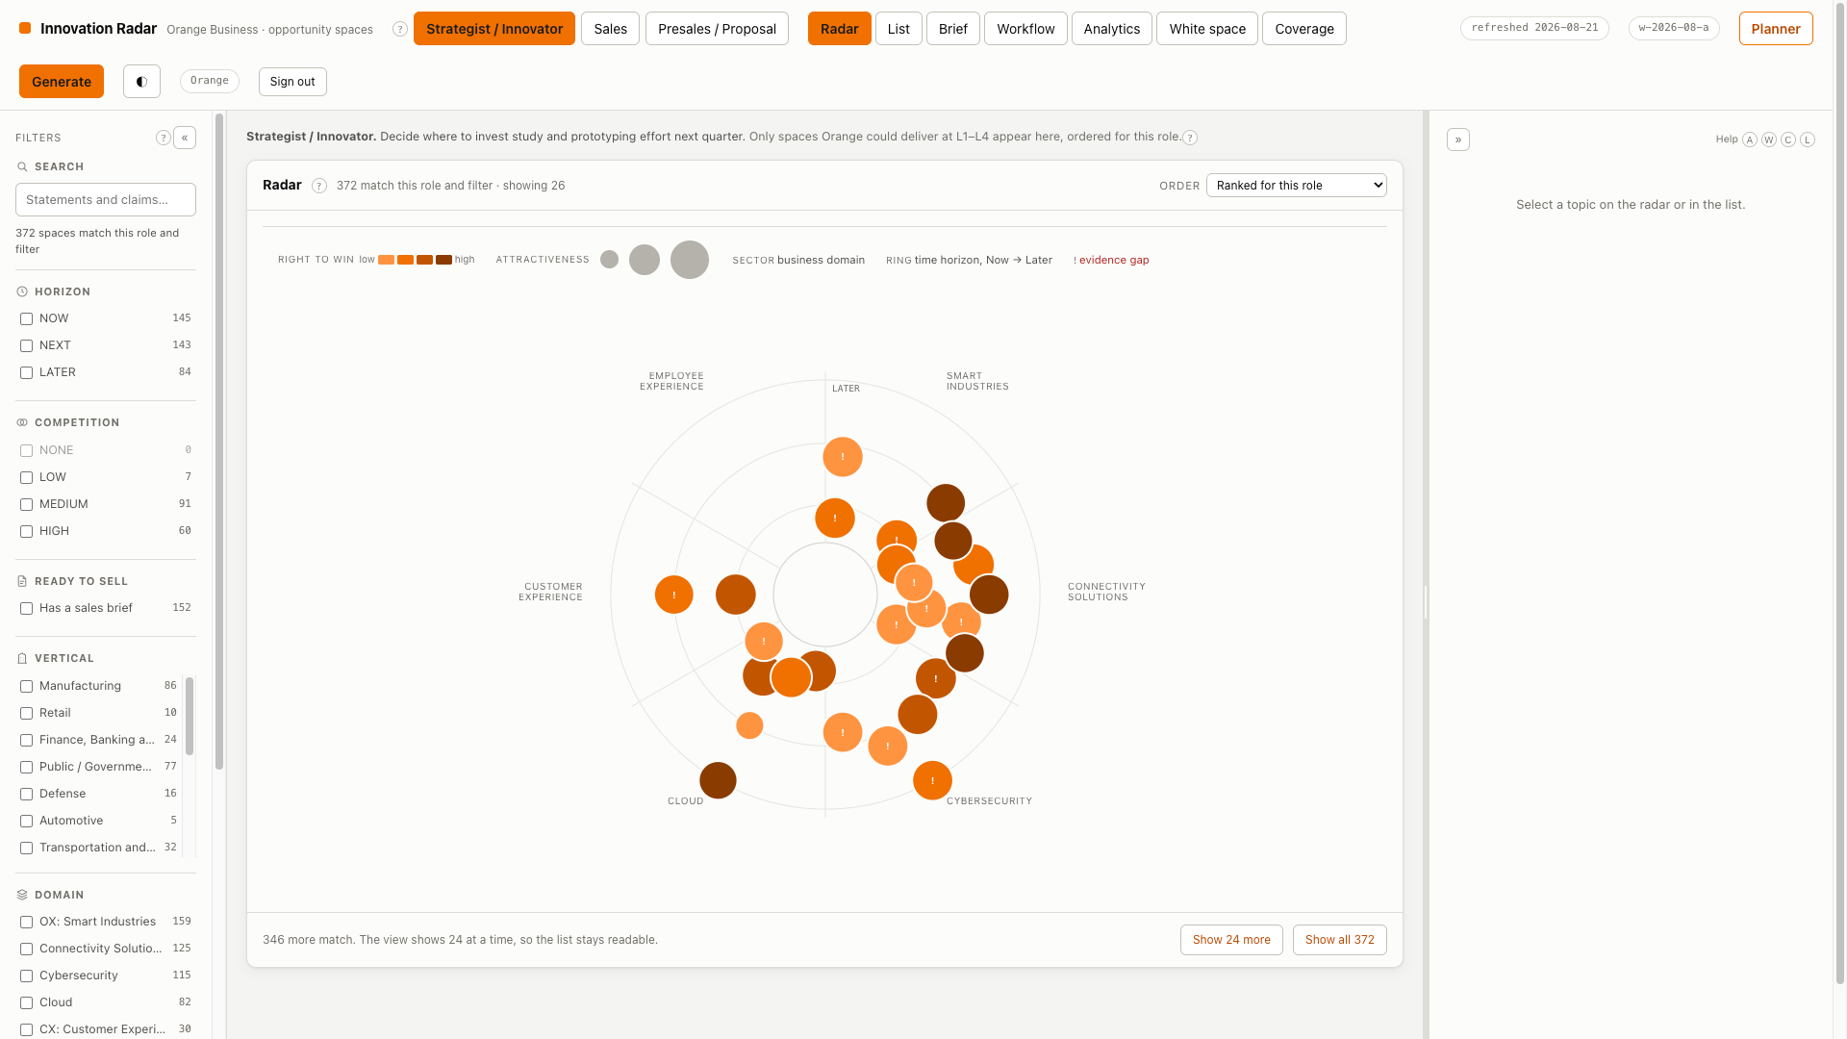
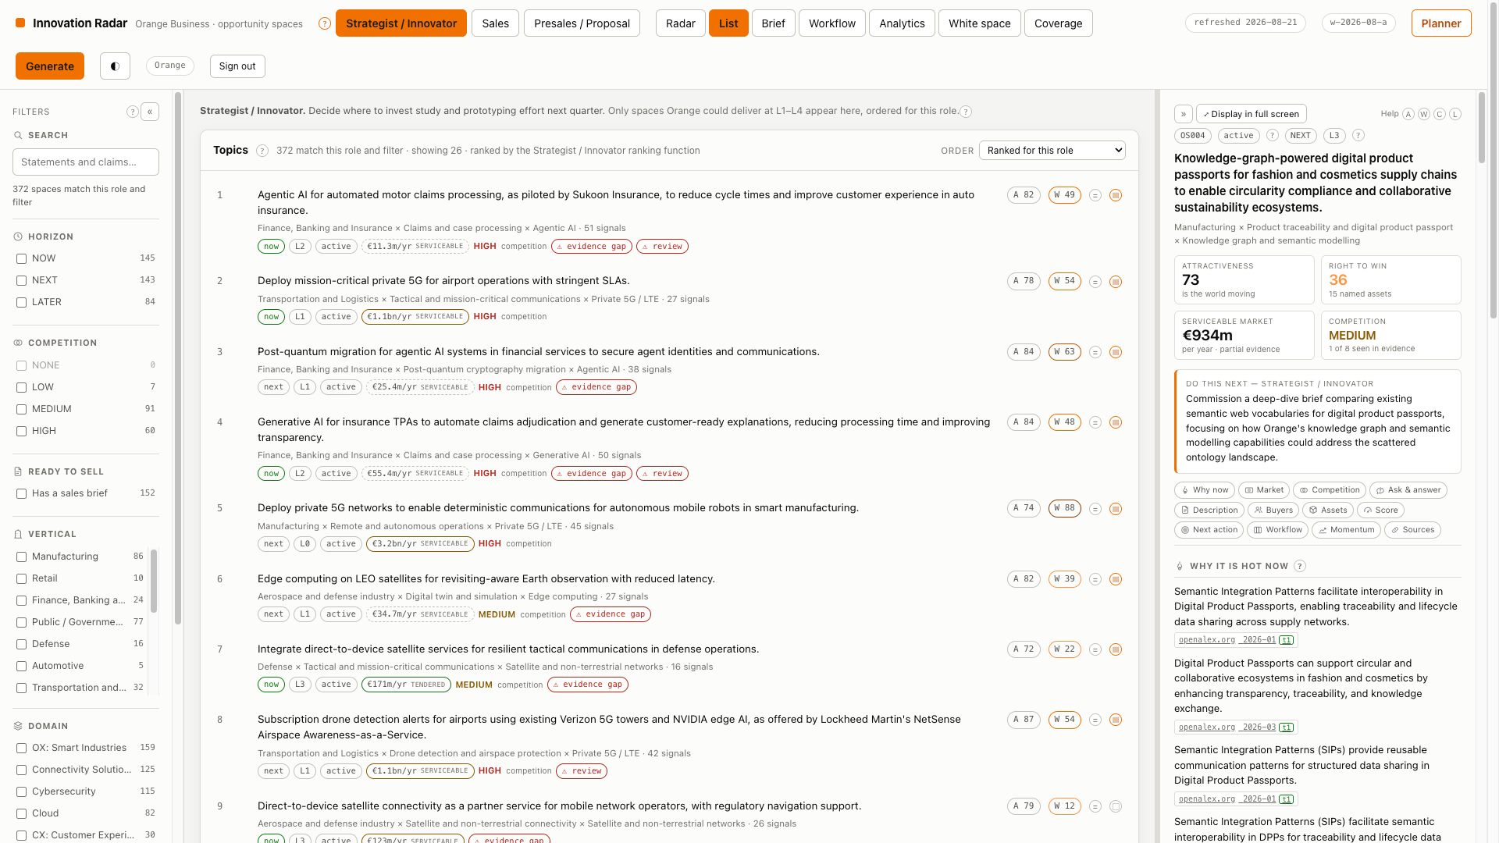
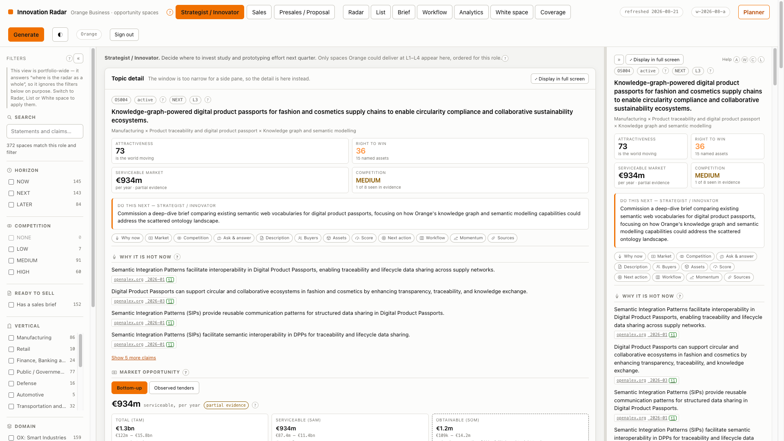
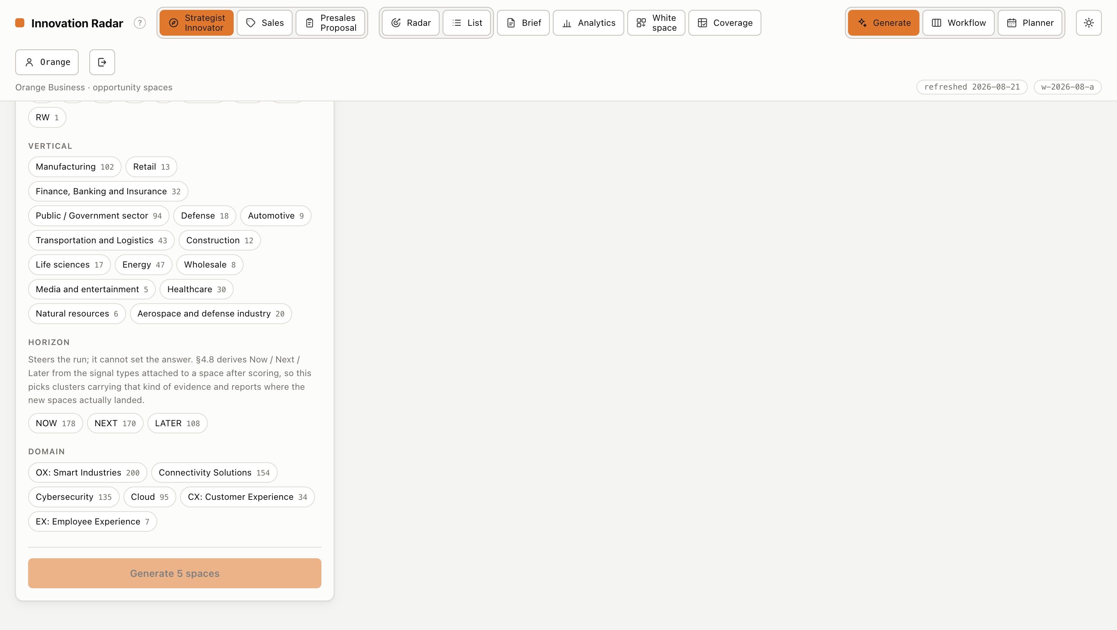
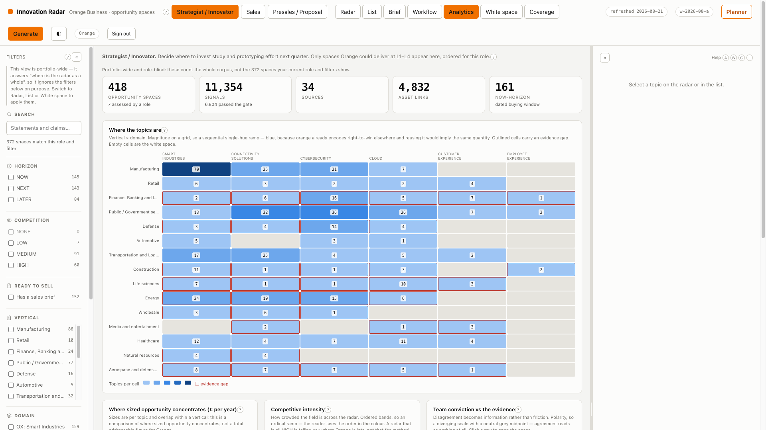
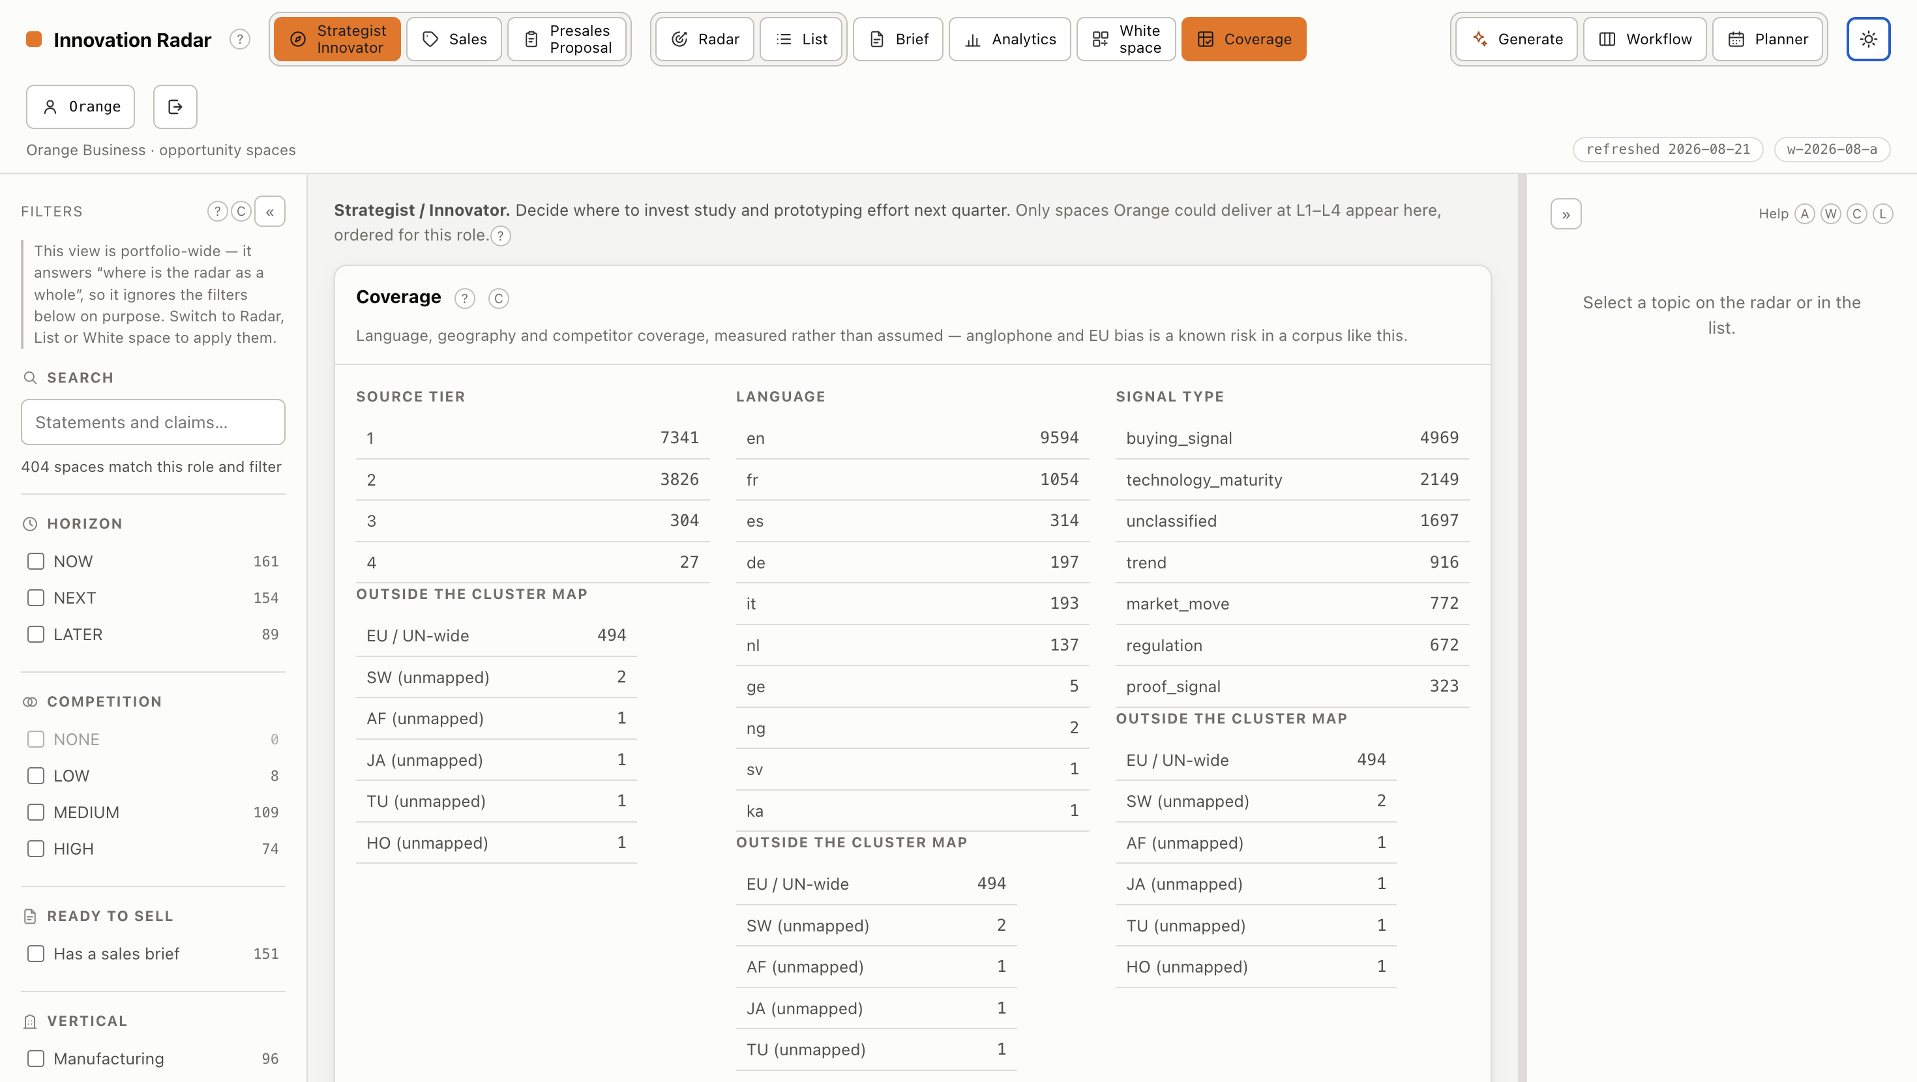
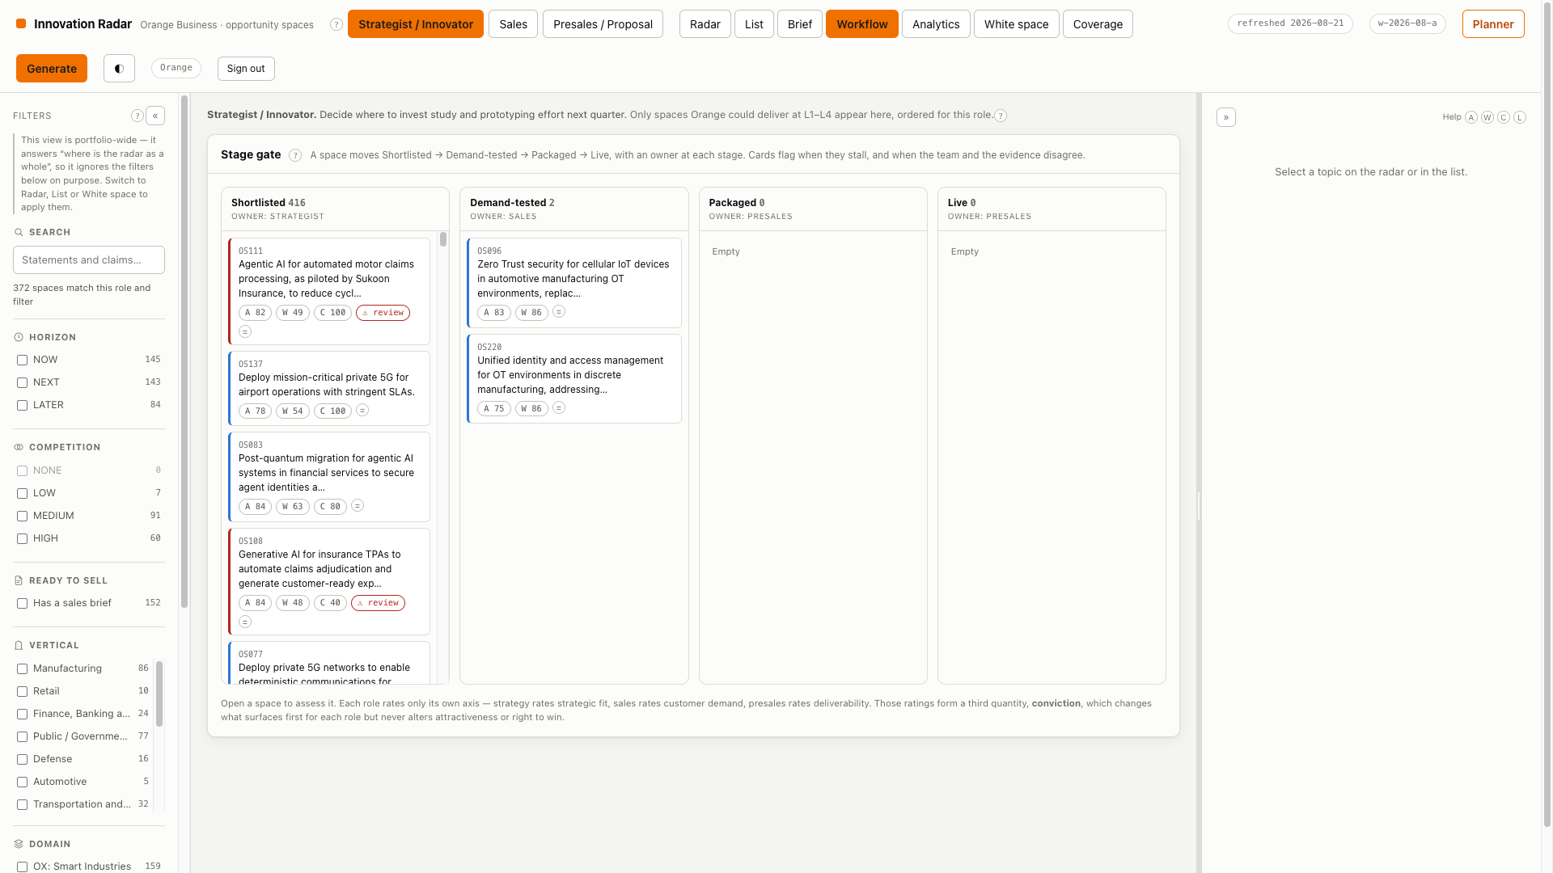
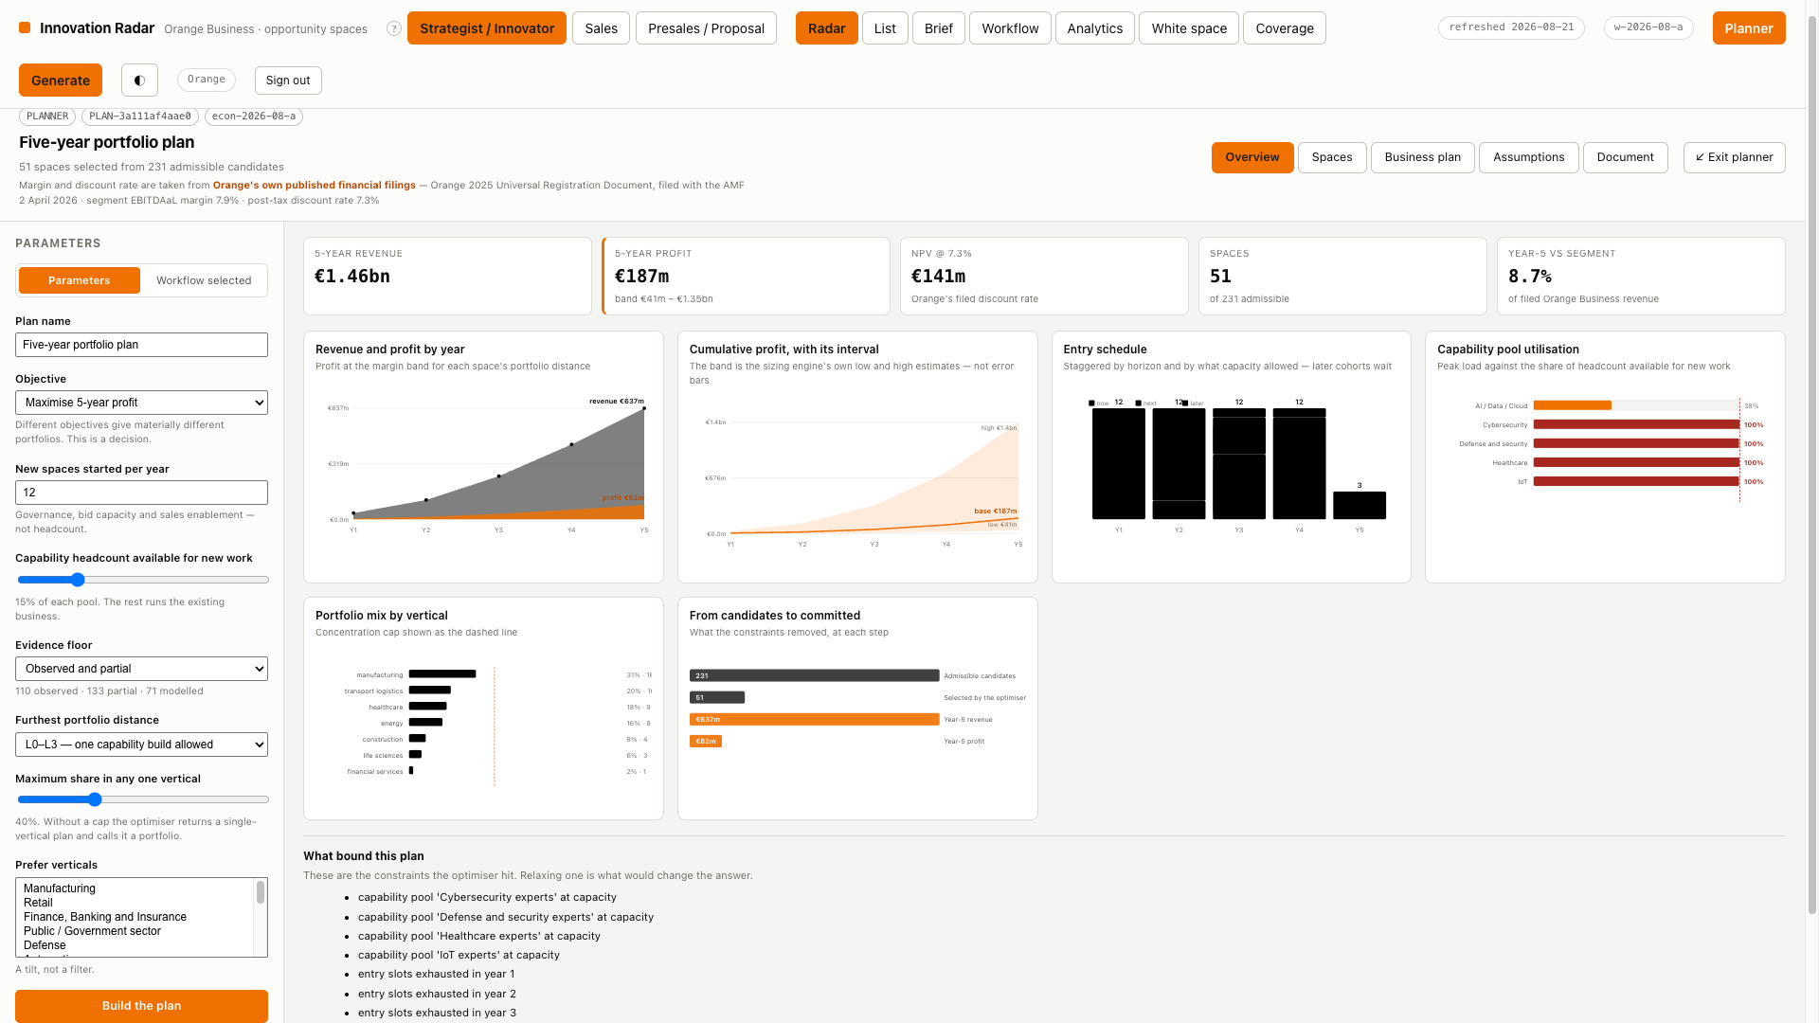
FUNCTIONALITY
MVP
Use the product for the functionality that was previously explained across separate slides.
Radar view
Role-ranked list
Topic detail
Generate
Analytics
Coverage
Workflow
The Planner
9
Orange Business · Opportunity Spaces / Innovation Radar
Notes:
Slide 8 — “Functionality”: the MVP walkthrough
This is where the deck stops explaining and starts demonstrating. Everything covered conceptually on the previous slides is now shown in the working product.
Eight surfaces make up the MVP. Radar view, role-ranked list, topic detail, generate, analytics, coverage, workflow, and the Planner.
The surfaces map directly to the concepts. The radar and role-ranked list express scoring and portfolio distance; topic detail exposes the triple, the evidence and the working behind sizing; generate is the evidence-first pipeline in action.
Coverage and analytics answer the “what are we missing?” question, while workflow and the Planner turn a topic into something someone actually acts on.
Bottom line: the MVP is not a mockup — the concepts explained so far are already usable end to end in the product.

Slide 9
STATUS
What the MVP has actually produced
Every figure below is read from the live database, not typed into this deck.
418
11,354
34
4,832
26.7
OPPORTUNITY SPACES
SIGNALS INGESTED
LIVE SOURCES
ASSET LINKS
SIGNALS PER TOPIC
15/15 verticals covered
6,804 passed the gate
33 enabled + internal intake
181 graph nodes
after enrichment
Coverage of the evidenced grid
47 of 59 use cases, 33 of 38 technologies appear in at least one topic — the grid is sparse by design.
7,267 tier-1 signals from regulators, procurement portals, standards bodies and official statistics.
1,054 French-language signals so the anglophone bias named as a principal risk is measured, not assumed.
314 sized bottom-up · 181 competition-scored · 174 briefed each with its method and its confidence grade, never a quoted headline.
8 portfolio plans · 12 kinds of pre-sales artefact built the two things that turn a ranked list into a decision and a bid.
Orange Business · Opportunity Spaces / Innovation Radar
10
Notes:
Slide 9 — “Status”: what the MVP has actually produced
Every figure is read live from the database, not typed into the deck — the status page is itself evidence that the system runs.
Scale today: 11,354 signals ingested from 34 live sources, 4,832 asset links across 181 graph nodes, and 418 opportunity spaces at 26.7 signals per topic after enrichment.
The gate is real: 6,804 of the ingested signals passed it, and 7,267 tier-1 signals come from regulators, procurement portals, standards bodies and official statistics.
Coverage is deliberately sparse. All 15 verticals are covered, with 47 of 59 use cases and 33 of 38 technologies appearing in at least one topic — gaps are informative, not failures.
Known bias is measured, not assumed: 1,054 French-language signals directly address the anglophone bias flagged as a principal risk.
Depth beyond the list: 314 topics sized bottom-up, 181 competition-scored and 174 briefed — each with its method and confidence grade rather than a quoted headline.
It reaches decisions: 8 portfolio plans and 12 kinds of pre-sales artefact — the two things that turn a ranked list into a decision and a bid.
Bottom line: the MVP is running at real volume with its quality controls visible, and the numbers prove the pipeline end to end rather than illustrating it.

Slide 10
ARCHITECTURE
Seven pipeline stages, each with a contract
Stages can be developed, tested and replaced independently.
1 Collect
2 Normalise
3 Classify
4 Themes
5 Synthesise
5b Enrich
6 Score
7 Serve
connectors
ingest
ingest
themes
synthesis
enrich
graph + scoring
read model + api
source config → raw items
raw items → signal records
→ typed, tiered signals
→ theme clusters
→ candidate spaces
→ more evidence per topic
→ ranked spaces
→ radar, briefs, API
↑
PARALLEL, SLOWER PATH
Orange Business Graph
joins at stage 6
Offers · references · partners with tiers · certifications · analyst positions · capability pools · research assets
Links are typed L0–L4 and carry the evidence that justified them. Right-to-win can improve without re-running discovery.
TWO SUBSYSTEMS SIT BESIDE THE PIPELINE
THE PLANNER
planner.py · plan_report.py
PRE-SALES COLLATERAL
presales/
Reads the read model + assumptions → selects a set → schedules it → projects five years → writes one PDF.
Reads ONE snapshot of a space → emits 12 artefacts in 5 formats.
One model call, after every number is fixed.
Nothing in a pack can disagree with anything else in it.
Orange Business · Opportunity Spaces / Innovation Radar
11
Notes:
Slide 10 — “Architecture”: seven pipeline stages, each with a contract
Every stage has a defined input and output contract, so stages can be developed, tested and replaced independently.
The seven stages: collect (source config → raw items), normalise (raw items → signal records), classify (→ typed, tiered signals), themes (→ theme clusters), synthesise (→ candidate spaces), score (→ ranked spaces) and serve (→ radar, briefs, API).
Enrichment runs as a parallel, slower path that gathers more evidence per topic and joins back at the scoring stage, so depth never blocks throughput.
The Orange Business Graph is the right-to-win backbone — offers, references, partners with tiers, certifications, analyst positions, capability pools and research assets. Links are typed L0–L4 and carry the evidence that justified them, so right-to-win can improve without re-running discovery.
Two subsystems sit beside the pipeline. The Planner reads the read model plus assumptions, selects and schedules a set, projects five years and writes a single PDF. Pre-sales collateral reads one snapshot of a space and emits 12 artefacts in 5 formats.
Consistency is engineered in: one model call after every number is fixed, so nothing in a pack can disagree with anything else in it.
Bottom line: contracts between stages are what make the system maintainable and auditable — parts can evolve independently without breaking the evidence chain.

Slide 11
ARCHITECTURE
Stack and separation of concerns
INGESTION
INTELLIGENCE
SERVING
33 enabled sources across 17 connector
types: TED, BOAMP, UK Contracts,
EUR-Lex SPARQL, Have-your-say, GDELT,
news RSS (EN/FR), Hacker News, OpenAlex,
Crossref, arXiv, CORDIS, NIST, CERT-FR
Parallel fetch · circuit breaker ·
per-host pacing · replay-safe dates
DeepSeek behind a provider-agnostic
client (swap to Ollama via .env alone)
Local sentence-transformers for
embeddings and clustering
Deterministic where possible,
generative only where it earns its place
SQLite — the graph is thousands of
nodes, not millions
FastAPI read API behind a session
guard applied to the whole app,
not route by route
React + Vite + TypeScript
Hand-drawn SVG radar, no chart library
scipy milp for portfolio selection
reportlab / python-pptx / python-docx
for every document it emits
Taxonomies, weights, thresholds, sources, the business graph and the crosswalks are all configuration, not code — and are validated at load time, so a dangling id is a startup error rather than a wrong number three stages later.
Orange Business · Opportunity Spaces / Innovation Radar
12
Notes:
Slide 11 - Architecture: stack and separation of concerns
Three clean layers. Ingestion, intelligence and serving are separated so each can be reasoned about, tested and swapped on its own.
Ingestion is broad and disciplined: 33 enabled sources across 17 connector types, with parallel fetch, circuit breakers, per-host pacing and replay-safe dates.
Intelligence avoids lock-in. The language model sits behind a provider-agnostic client that can be swapped through configuration alone, with local sentence-transformers handling embeddings and clustering.
Deterministic where possible, generative only where it earns its place - the model is used sparingly and on purpose.
Serving is deliberately right-sized: a lightweight database because the graph is thousands of nodes, not millions; a read API behind a session guard applied to the whole app rather than route by route; and a modern front end with a hand-drawn radar rather than a chart library.
Documents and selection use proper tooling for portfolio optimisation and for every artefact the system emits.
Configuration, not code. Taxonomies, weights, thresholds, sources, the business graph and the crosswalks are all configuration, validated at load time - so a dangling id is a startup error rather than a wrong number three stages later.
Bottom line: the stack is chosen for auditability and replaceability over scale for its own sake - failures surface early and loudly instead of silently corrupting results.

Slide 12
ARCHITECTURE
What makes the numbers defensible
The governing constraint: if a user cannot explain why a topic is ranked where it is, the scoring is not good enough.
Decomposable
Reproducible
Every displayed number breaks into named components; no opaque scores.
Every component stores the inputs used to compute it, so any number can be re-derived.
Traceable
Versioned
Full lineage from a displayed claim back to the raw ingested item, including prompt and model version.
Every score records its weight set. Trajectories are never plotted across a boundary silently.
Auditable
Bounded
A reviewer outside the project can reconstruct why any topic holds its rank.
Counting, diversity, recency and momentum are arithmetic — never a model. A model asked to count is unverifiable.
Orange Business · Opportunity Spaces / Innovation Radar
13
Notes:
Slide 12 - Architecture: what makes the numbers defensible
The governing constraint: if a user cannot explain why a topic is ranked where it is, the scoring is not good enough.
Decomposable. Every displayed number breaks into named components - there are no opaque scores.
Reproducible. Every component stores the inputs used to compute it, so any number can be re-derived.
Traceable. There is full lineage from a displayed claim back to the raw ingested item, including the prompt and model version.
Versioned. Every score records its weight set, and trajectories are never plotted across a boundary silently.
Auditable. A reviewer outside the project can reconstruct why any topic holds its rank.
Bounded. Counting, diversity, recency and momentum are arithmetic, never a model - a model asked to count is unverifiable.
Bottom line: defensibility is designed in, not asserted - the ranking can be challenged, re-derived and audited by someone outside the project.

Slide 13
The join is the product
Without it the radar is a competent trend feed, and trend feeds already exist. With it, the radar answers a question nobody else can answer for Orange.
418 opportunity spaces · 11,354 signals · 34 live sources · 4,832 named asset links
314 sized bottom-up · 174 sales briefs · 12 pre-sales artefacts per space · 8 portfolio plans

